Slide 1
Session 2.1: Cognitive Security Frameworks
Disinformation/Malign Influence Training
SJ Terp & P Breuer, Threet Consulting | 2021

Slide 2
Cognitive security models and frameworks
Models
Layer-based models
Group-based models
(Network-flow models)
Frameworks for understanding cognitive security
Object-based models
Behaviour-based models
Notes:
So models vs frameworks. A model is a representation of part of the world. It might be physical or conceptual, but it’s trying to capture something that exists.
A framework represents the structure that underlies a concept or a system. It captures what exists or is happening in the world, in a way that you can manipulate it.

Slide 3
Models vs frameworks

Slide 4
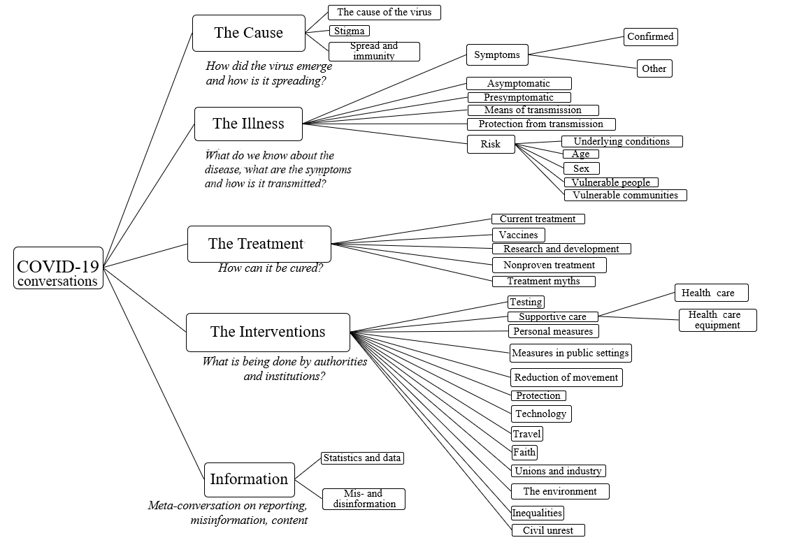
WHO Covid19 Narratives Model
Notes:
Similarly, the conspiracy chart is a set of organised labels.
Links:
https://drive.google.com/file/d/1QYfof919nxaO73hrhTvDsafD_egyF5Wg/view

Slide 5
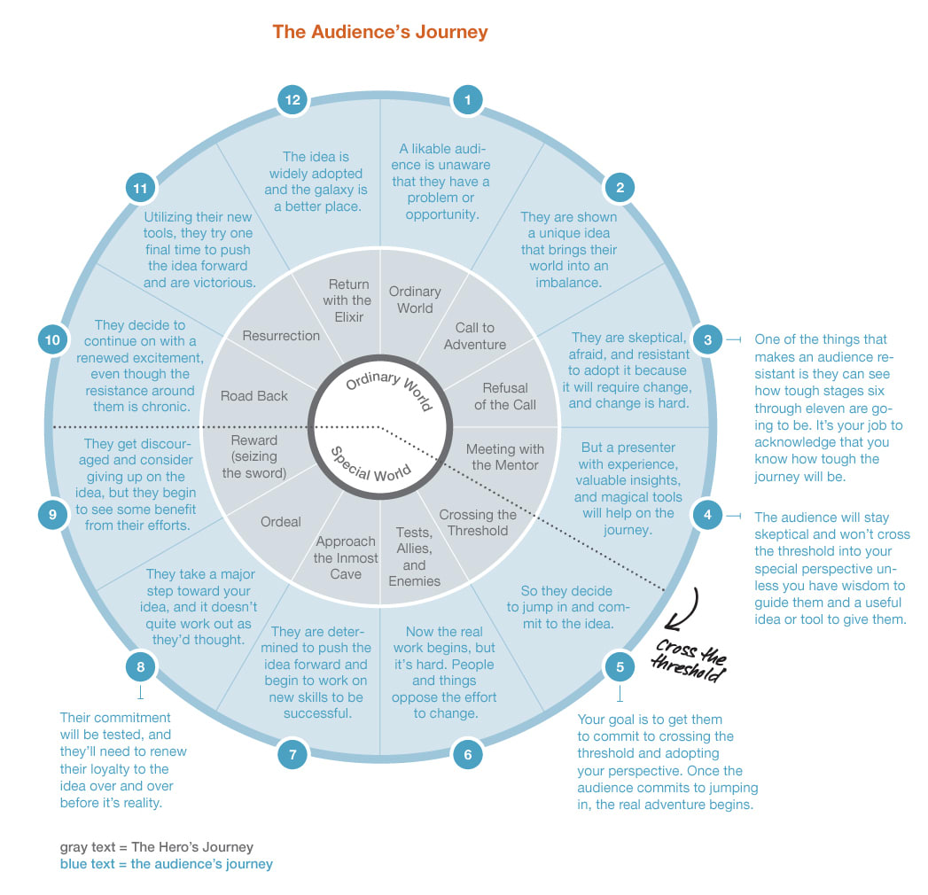
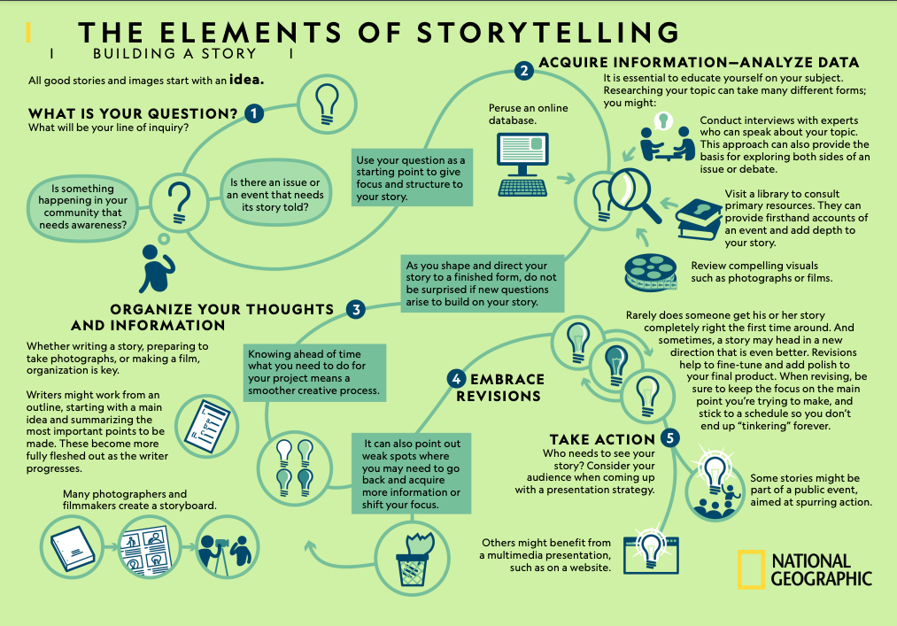
Storytelling frameworks: story journeys
Notes:
Links
Hero’s journey https://www.peterfisk.com/2020/02/the-best-storytelling-frameworks-for-business-from-pyramid-thinking-to-the-heros-journey-steve-jobs-iphone-speech-and-mlks-i-have-a-dream/
https://www.nationalgeographic.org/media/elements-storytelling/

Slide 6
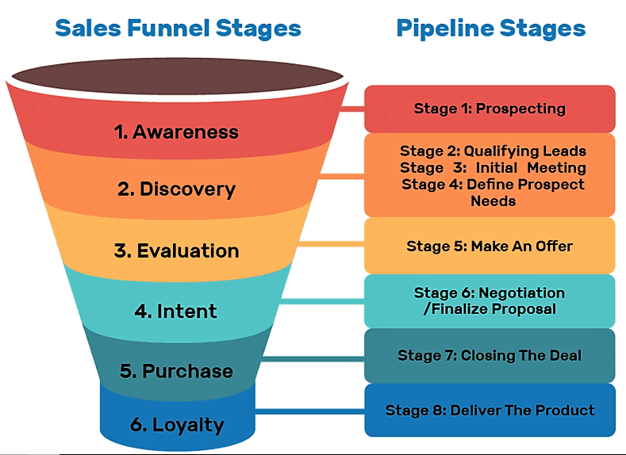
Sales funnels are stories too
Notes:
A sales funnel shows the stages that someone goes through, from being aware of a product to buying it
Links:
https://suzanneperkinsm.medium.com/what-is-a-sales-funnel-and-why-websites-dont-work-anymore-1450fc99e69b

Slide 7
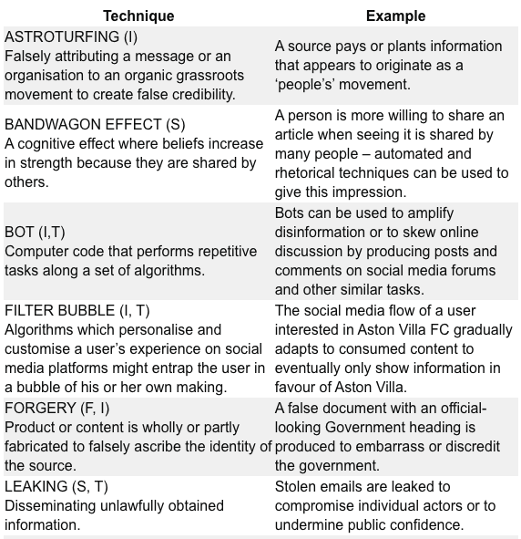
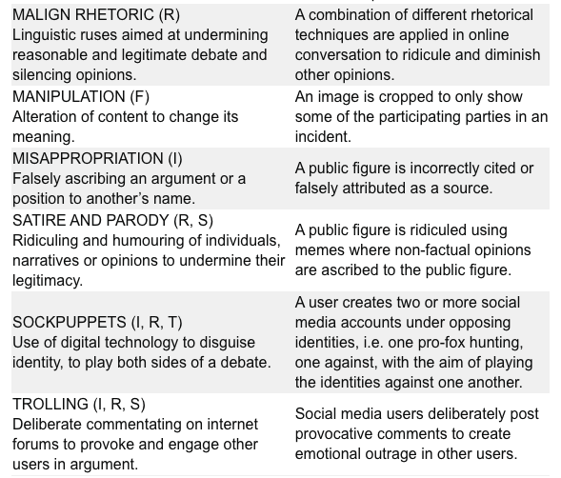
RESIST Behaviours models
Notes:
https://gcs.civilservice.gov.uk/publications/resist-counter-disinformation-toolkit/

Slide 8
4D Model of disinformation campaigns (Nimmo)
Dismiss: if you don’t like what your critics say, insult them.
Distort: if you don’t like the facts, twist them.
Distract: if you’re accused of something, accuse someone else of the same thing.
Dismay: if you don’t like what someone else is planning, try to scare them off.
Notes:
https://online.umich.edu/teach-outs/disinformation-misinformation-and-fake-news-teach-out/lessons/4d-model-disinformation-campaigns/

Slide 9
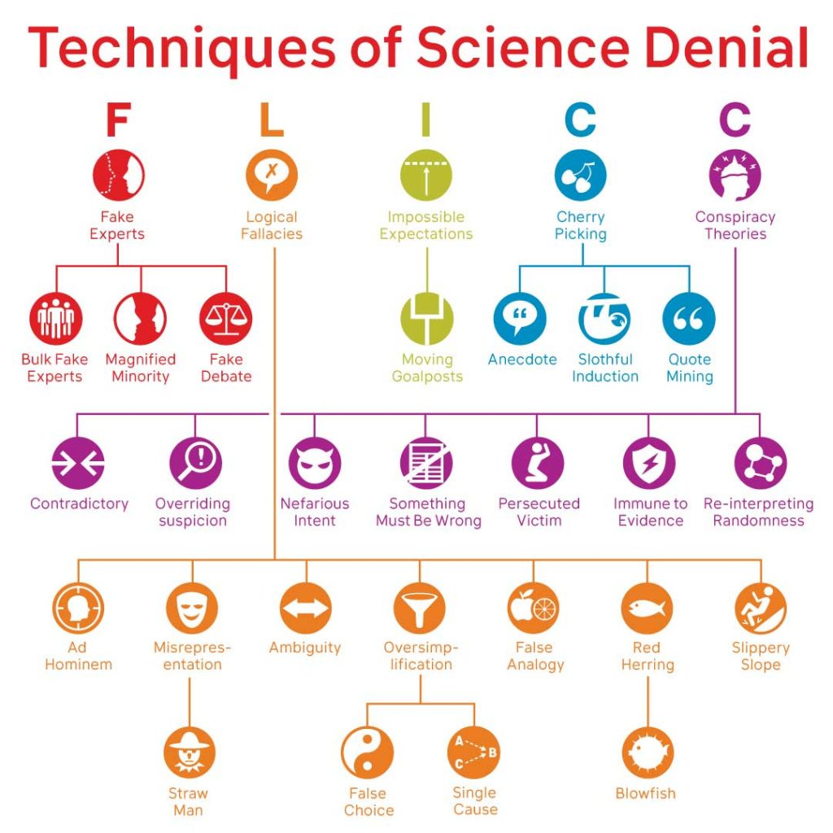
FLICC
John Cook
Denial tactics:
Fake experts
Logical fallacies
Impossible expectations
Cherry picking
Conspiracy theories
Originally designed for climate change, HIV/AIDs etc crossover
Notes:
https://skepticalscience.com/history-FLICC-5-techniques-science-denial.html

Slide 10
Layer-based models

Slide 11
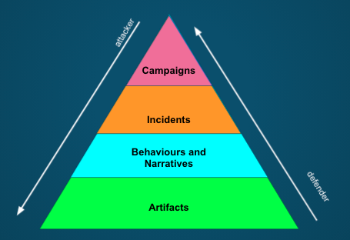
Disinformation pyramid

Slide 12
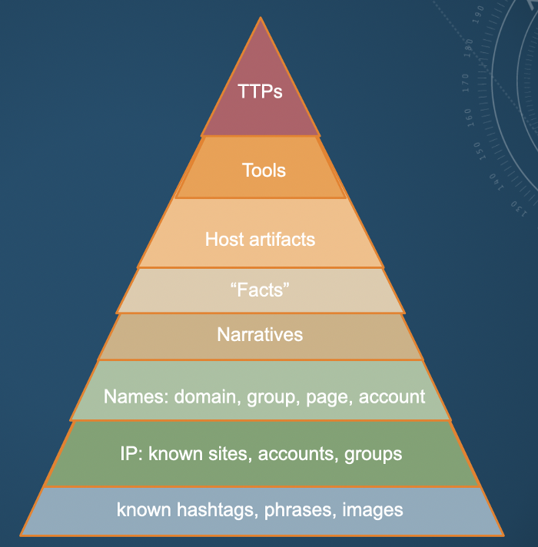
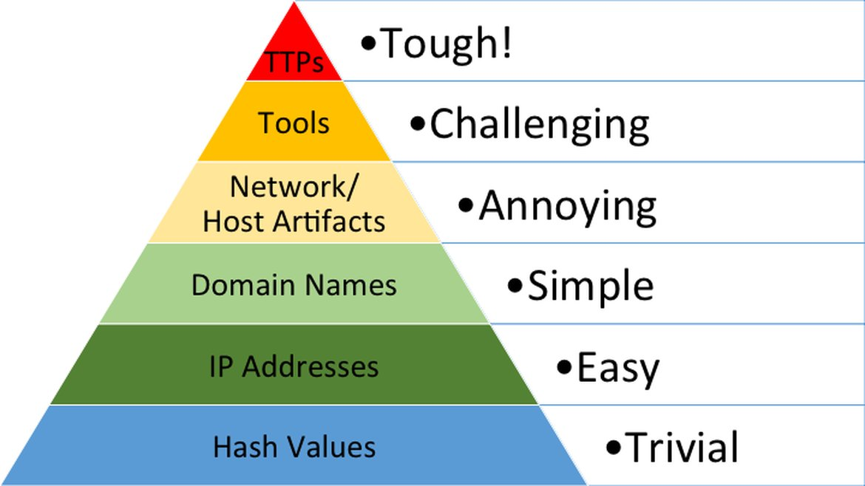
Pyramids of pain
Notes:
https://sarajayneterp.medium.com/cognitive-security-pyramid-of-pain-3f0f860e86cd

Slide 13
Frameworks

Slide 14
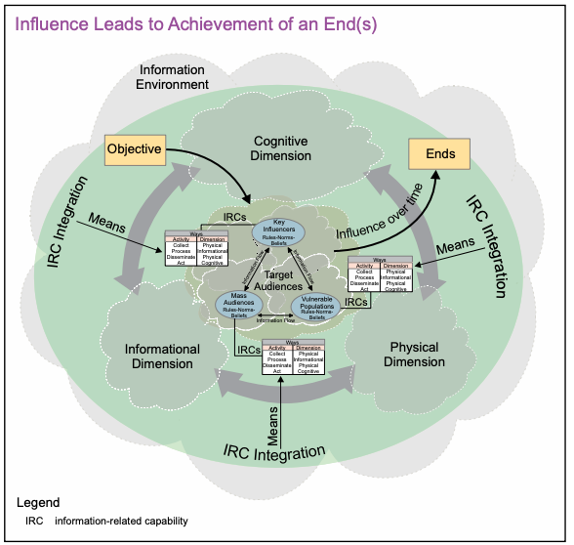
Influence framework:
Means (what)
Ways (how)
Ends (why)

Slide 15
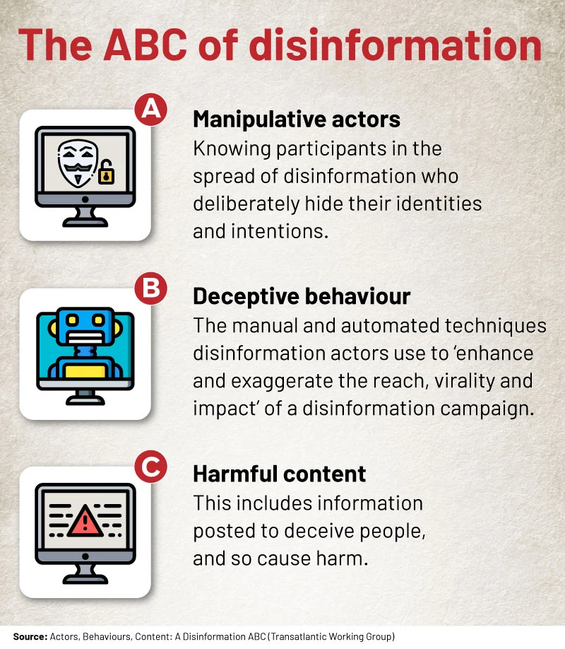
ABC (Francois), ABCDE (Pamment)
Actor | What kinds of actors are involved? This question can help establish, for example, whether the case involves a foreign state actor
Behavior | What activities are exhibited? This inquiry can help establish, for instance, evidence of coordination and inauthenticity
Content | What kinds of content are being created and distributed? This line of questioning can help establish, for example, whether the information being deployed is deceptive.
Degree | What is the overall impact of the case and whom does it affect? This question can help establish the actual harms and severity of the case.
Effect | What is the overall impact of the case and whom does it affect? This question can help establish the actual harms and severity of the case.
Notes:
Links:
ABC from https://africacheck.org/fact-checks/reports/anatomy-disinformation-campaign-who-what-and-why-deliberate-falsehoods-twitter
ABCDE: https://carnegieendowment.org/2020/09/24/eu-s-role-in-fighting-disinformation-crafting-disinformation-framework-pub-82720

Slide 16
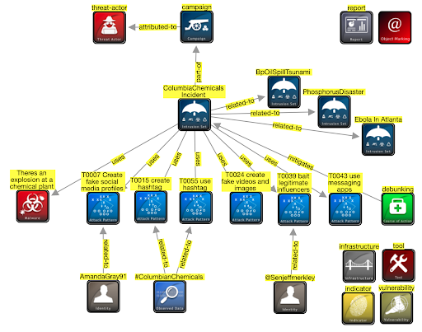
AMITT STIX

Slide 17
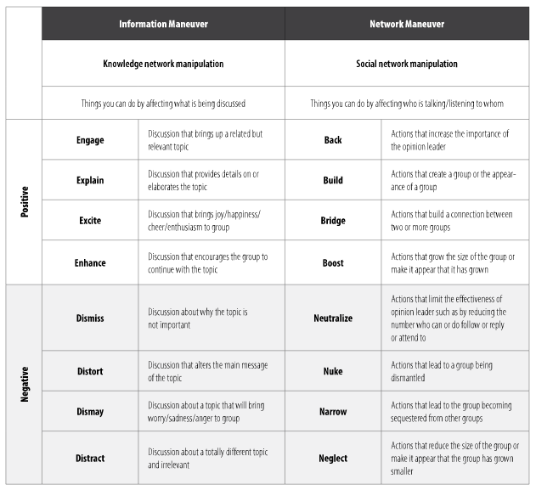
Behaviour:
BEND (Carley)
Notes:
https://www.armyupress.army.mil/Journals/Military-Review/English-Edition-Archives/Mar-Apr-2019/117-Cybersecurity/b/

Slide 18
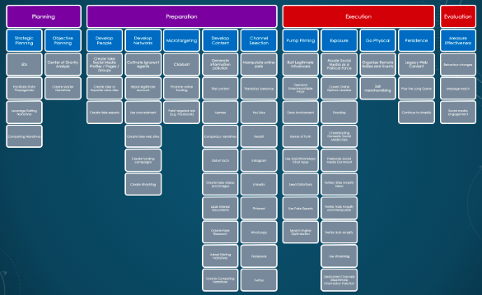
Behaviour: AMITT Red
Notes:
SJ Terp et al

Slide 19
Session 2.2: Risk Management
Disinformation/Malign Influence Training
SJ Terp & P Breuer, Threet Consulting | 2021

Slide 20
Cognitive security risk management
Cognitive security as risk management
Risks created by misinformation and influence operations
Frameworks for assessing cognitive security risks
Monitoring and Evaluation
Measuring disinformation risk, disinformation actions, and response actions, at tactical and organisational levels.
Applied cynicism: statistics and modelsa

Slide 21
Risk Management

Slide 22
Disinformation as a risk management problem
Manage the risks, not the artifacts
Attack surfaces, vulnerabilities, potential losses / outcomes
Risk assessment, reduction, remediation
Risks: How bad? How big? Who to?
Mis/disinformation is everywhere:
Where do you put your resources?
Detection, mitigation, response
People, technologies, time, attention
Connections
Notes:
What is being protected? From who?

Slide 23
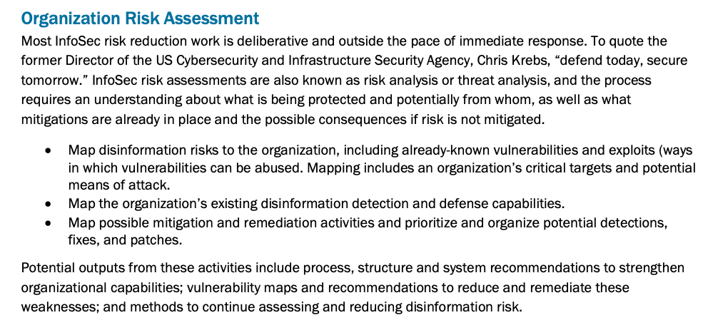
CogSec risk assessment (FiveBy report)
Notes:
Quote from fiveby.com

Slide 24
“Risk = Likelihood x Severity”

Slide 25
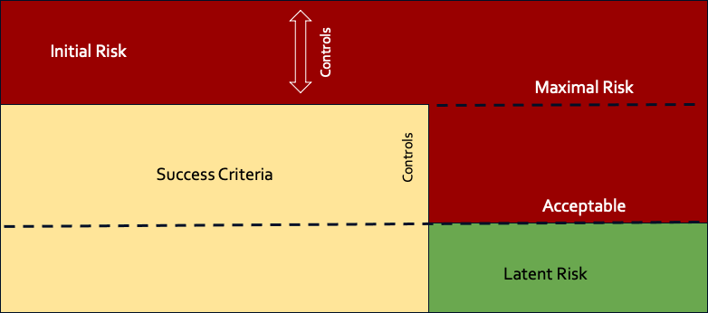
Operational Risk
Risk

Slide 26
Information Security Risk Considerations
Digital harms and losses
Size
Reach: people, topics, time
Likelihood
Vulnerabilities
The CIA triad
Threats
Attacker goals
Stakeholders
Mitigations and response
Notes:
CIA triad:
Confidentiality: only people who are supposed to see info can see it
Integrity: only people who are allowed to change data can change it
Availability: people who are supposed to use a system can

Slide 27
Harms: Potential outcomes and severity
Notes:
How do you know how well an influence campaign is doing?

Slide 28
Digital harms frameworks
Physical harm | e.g. bodily injury, damage to physical assets (hardware, infrastructure, etc).
Psychological harm | e.g. depression, anxiety from cyber bullying, cyber stalking etc
Economic harm | financial loss, e.g. from data breach, cybercrime etc
Reputational harm | e.g. Organization: loss of consumers; Individual: disruption of personal life; Country: damaged trade negotiations.
Cultural harm | increase in social disruption, e.g. misinformation creating real-world violence.
Political harm | e.g. disruption in political process, government services from e.g. internet shutdown, botnets influencing votes
(List from https://dai-global-digital.com/cyber-harm.html)
Notes:
We’re looking for, and trying to reduce, harms. In this deployment, we’re specifically looking for medical harms. This is important because this year, social media companies, politicans etc shifted their definition of ‘bad’ from immediate calls for violence to the idea of digital harms where the effects might be delayed.
Needs a “helps” equivalent for positive outcomes from actions, response etc - see G’s kick the fulcrum.
Links
https://www.researchgate.net/figure/Taxonomy-of-organizational-cyber-harms_fig1_328328197

Slide 29
Responder Harms Management
Psychological damage
Disinformation can be distressing material. It's not just the hate speech and _really_ bad images that you know are difficult to look at - it's also difficult to spend day after day reading material designed to change beliefs and wear people down. Be aware of your mental health, and take steps to stay healthy
(this btw is why we think automating as many processes as make sense is good - it stops people from having to interact so much with all the raw material).
Security risks
Disinformation actors aren't always nice people. Operational security (opsec: protecting things like your identity) is important
You might also want to keep your disinformation work separated from your dayjob. Opsec can help here too.

Slide 30
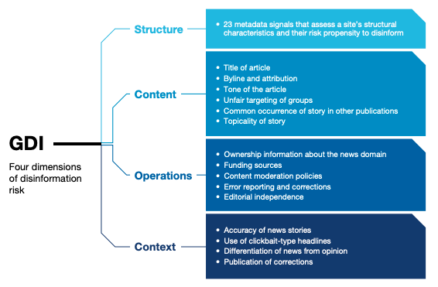
GDI: Domain harms
Notes:
https://disinformationindex.org/wp-content/uploads/2019/12/GDI_Index-Methodology_Report_Dec2019.pdf
UK-based domain disinformation consultancy
Techniques rooted in infosec methods
Aimed at adtech companies

Slide 31
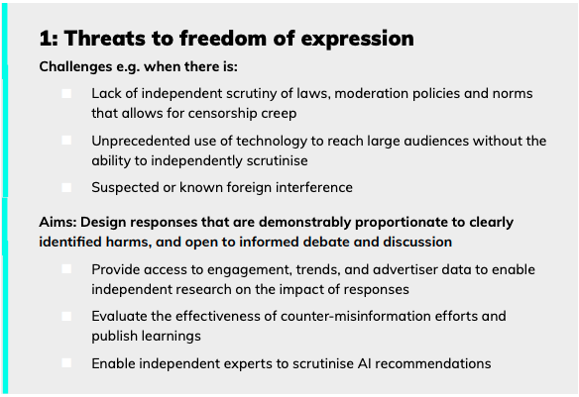
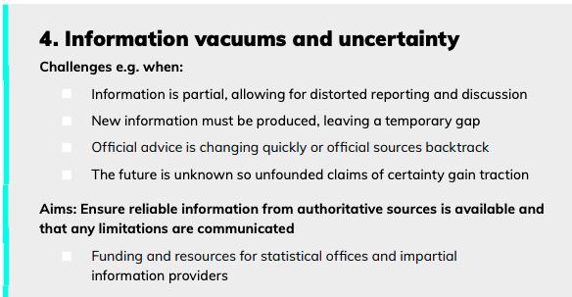
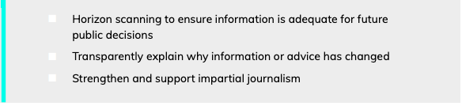
Full fact (8) threats (“challenges”), including:

Slide 32
Sizing: Monitoring and Evaluation
Notes:
How do you know how well an influence campaign is doing?

Slide 33
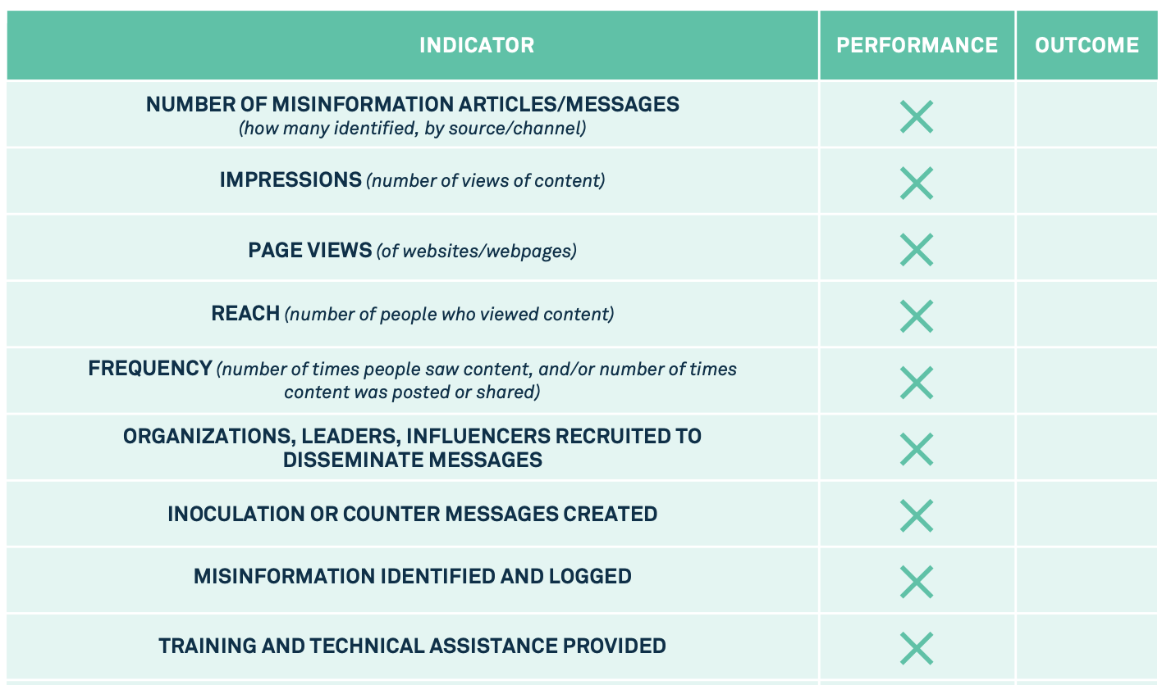
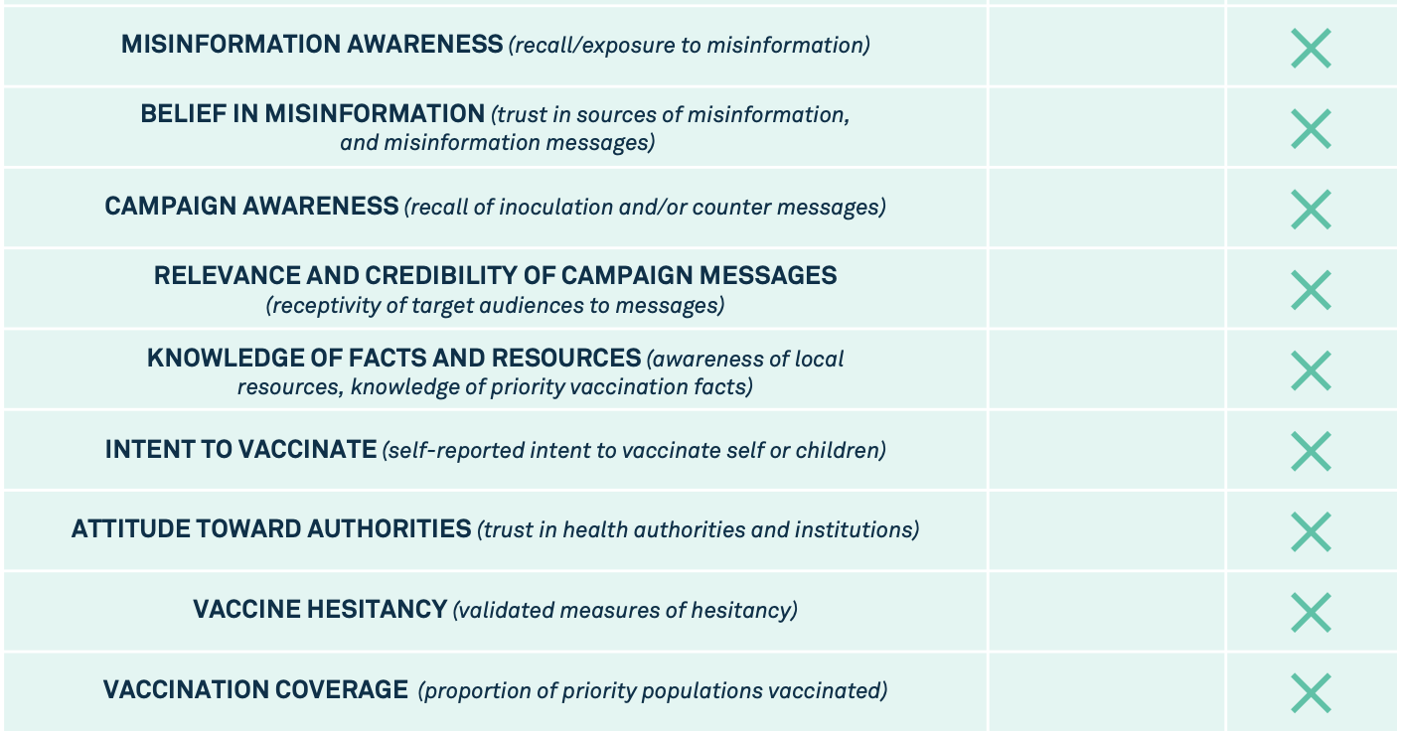
UNICEF: Infodemic Measures
Notes:
https://vaccinemisinformation.guide/

Slide 34
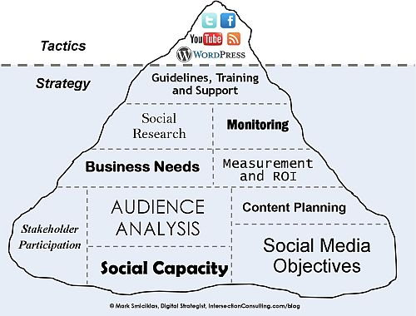
Marketing has a lot to teach us
Notes:
Links
Image: https://www.flickr.com/photos/intersectionconsulting/5332653015

Slide 35
Risk Frameworks

Slide 36
Risk Framework Assessment
Which tradition does this come from?
Who is this framework *for* (scale, resources, timescales etc)
Does this meet what I need for:
Strategy
Risk mitigation
Incident response
Etc
Will it be used
Is it simple enough
Is it detailed enough

Slide 37
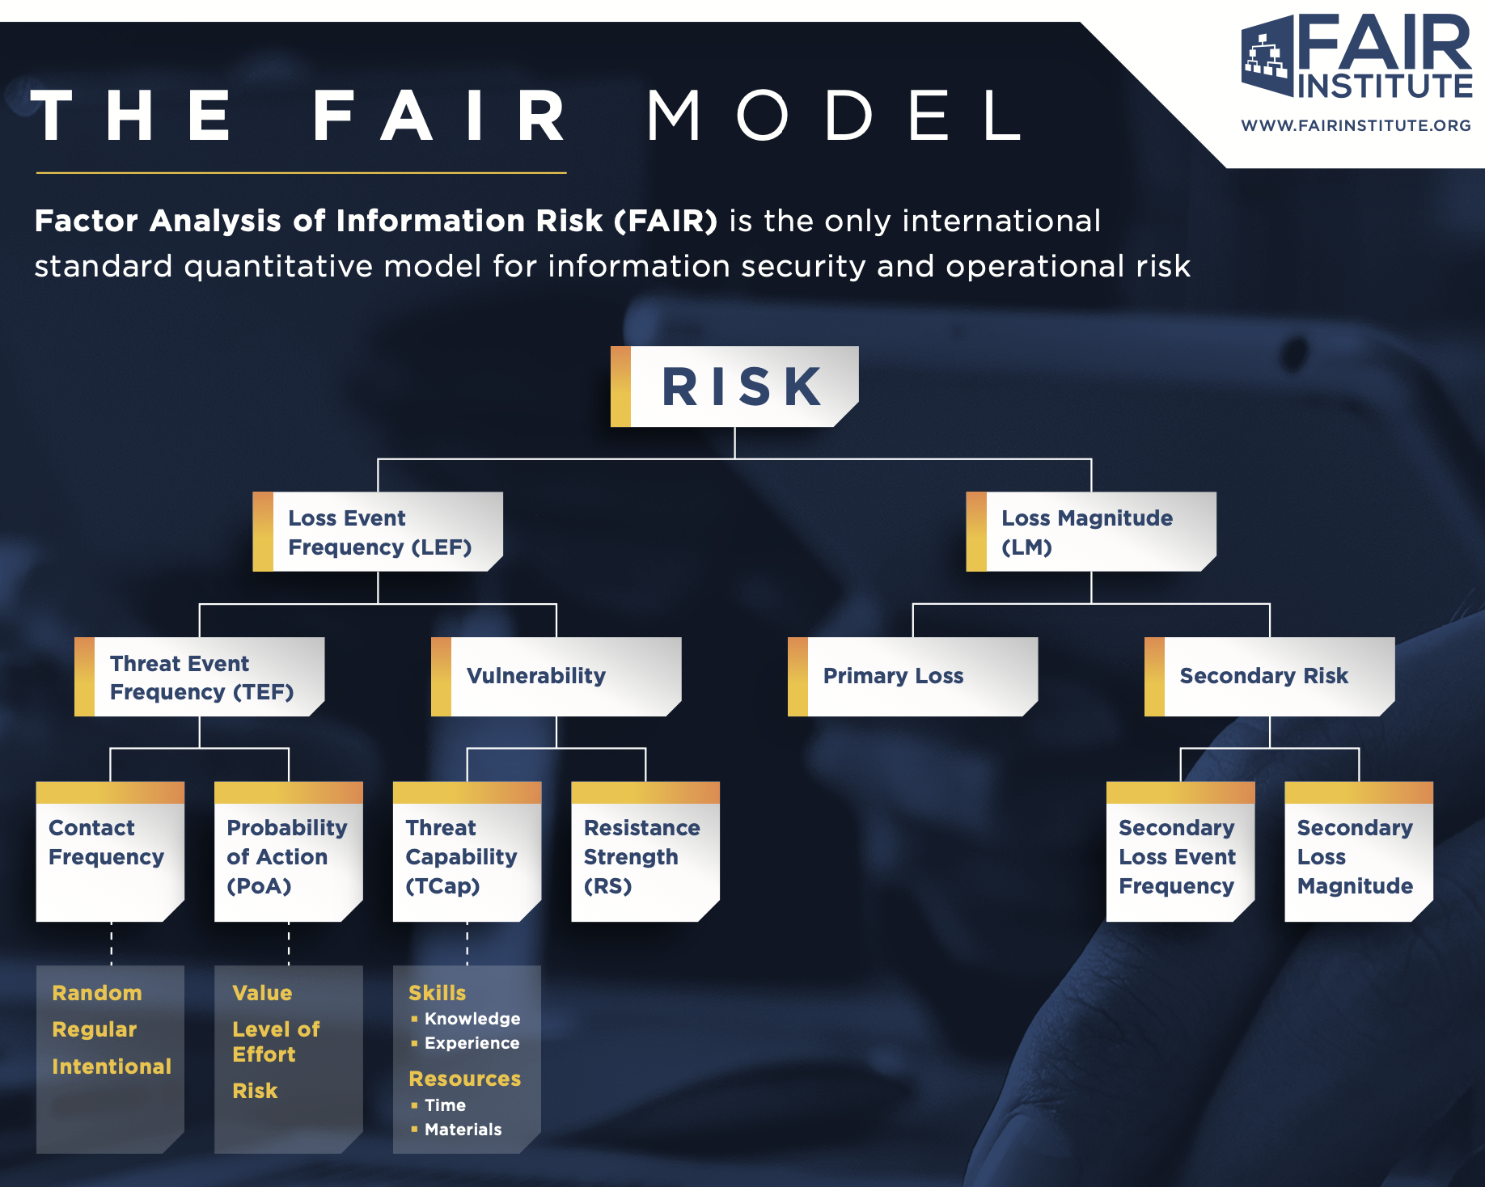
Notes:
Image: the FAIR model on one page

Slide 38
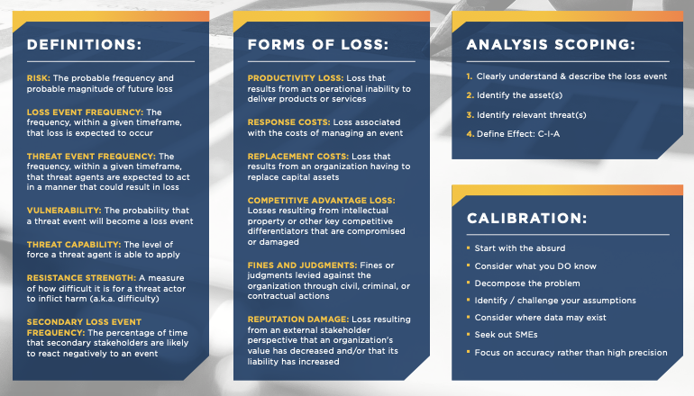
Notes:
Image: the FAIR model on one page

Slide 39
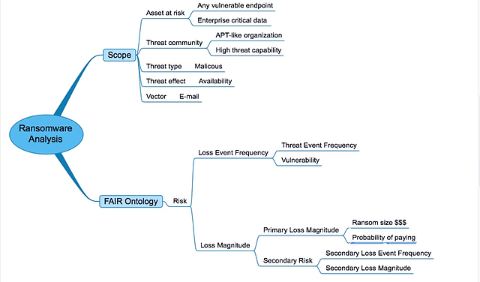
FAIR example
Notes:
Image from https://www.fairinstitute.org/blog/ransomware-risk-setting-up-a-fair-analysis

Slide 40
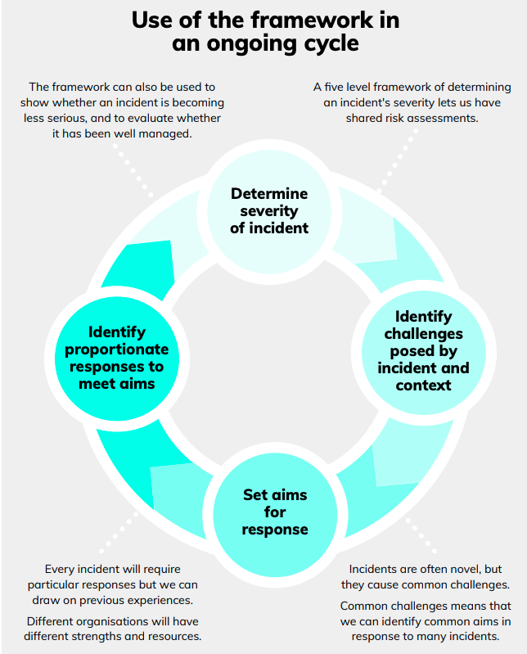
FullFact risk-levels framework
UK fact checking organisation
Techniques rooted in UN-style country assessments
Aimed at large-scale response level (region, country, international organisation, etc)
Blunt instrument
Notes:
This is the closest thing we’ve got at the moment.
Links:
https://fullfact.org/media/uploads/framework-information-incidents-consulation.pdf

Slide 41
FullFact: separates risk/response into levels
Levels:
Business as normal, no additional response needed
Monitor and prepare external facing responses
An incident is occurring, responses ramp up
An incident is occurring, coordinated responses start
Maximum response levels and cooperation required
Criteria:
Reach
Subject matter
Urgency of response
Collaboration

Slide 42
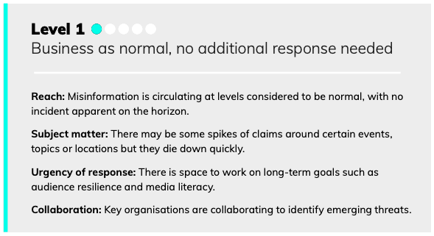
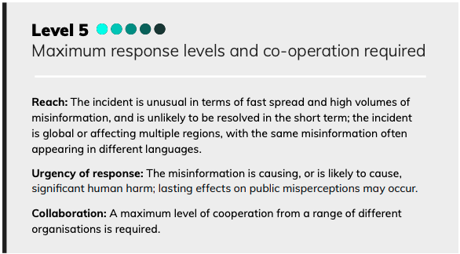
FullFact: Level 1, Level 5

